Slide 1

Residual Closeness in Networks
Yucong Guo

Slide 2
Motivation
In class, we have discussed the centrality of a node in a network, which shows the importance of different nodes in a network.
Another measurement of a network is called vulnerability. It measures the vulnerability by removing vertices or links so the resulting graph is disconnected.
Residual closeness evaluates the closeness after we remove a vertex or a link in a network (the resulting graph does not have to be disconnected).
Know how a node will disturb the whole graph

Slide 3
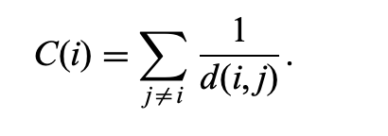
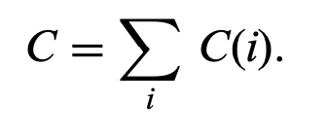
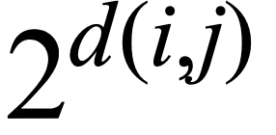
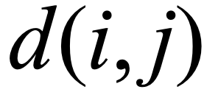

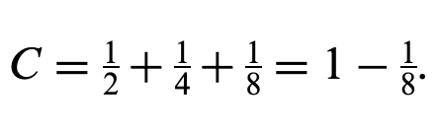

Closeness
Define closeness of node i
where d(i,j) is the distance between vertices i and j.
Define the closeness of the whole graph
For calculation simplicity, we use in stead of in the denominator

Slide 4

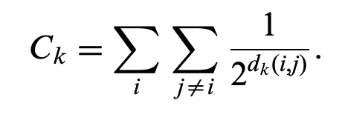
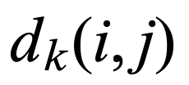

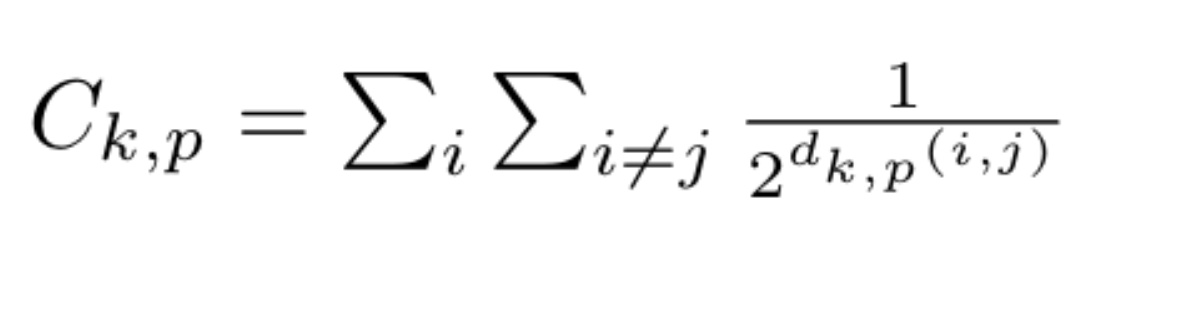
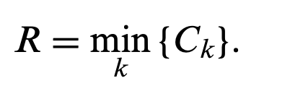
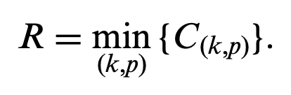
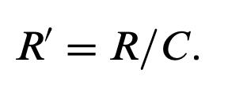
Residual Closeness
The closeness after remove vertex k:
where be the distance between vertices i and j in the remaining graph,
The closeness after remove one link (k,p)
vertex residual closeness (VRC):
link residual closeness (LRC):
Normalization: where C is the original graph closeness

Slide 5
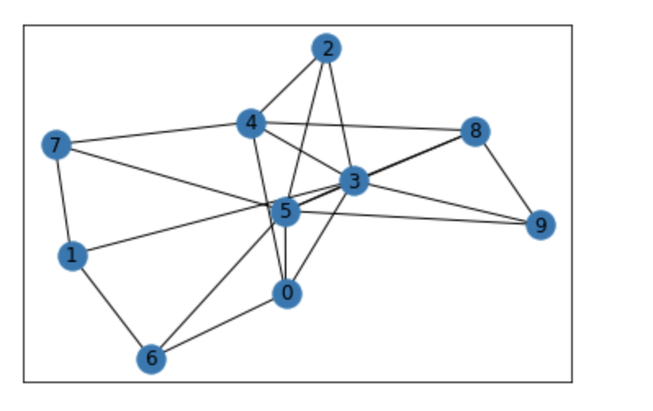
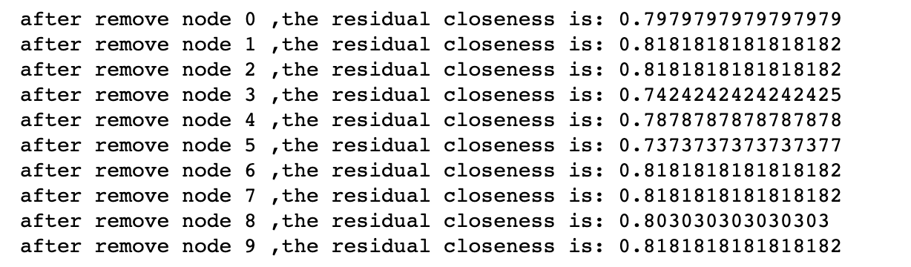
Example of Finding NVRC
Graph closeness=66
the node 5 will be the NVRC node
The residual closeness 0.73

Slide 6
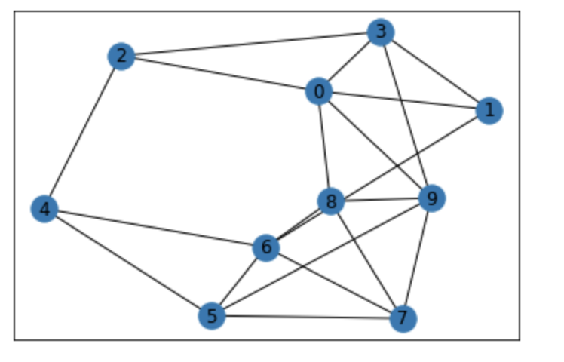
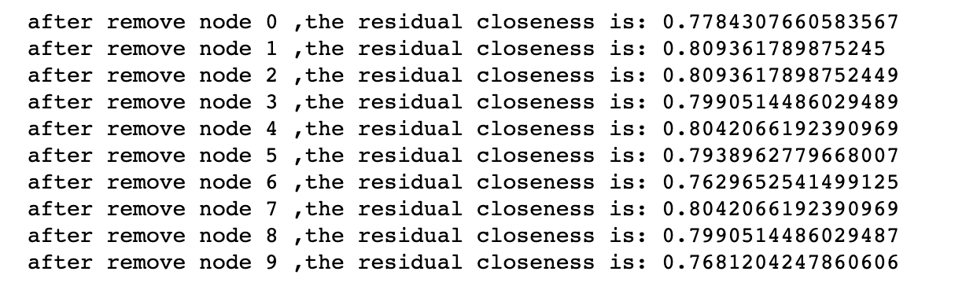
Example of Finding NVRC
Graph closeness=64.66
the node 6 will be the NVRC link
The residual closeness 0.76

Slide 7
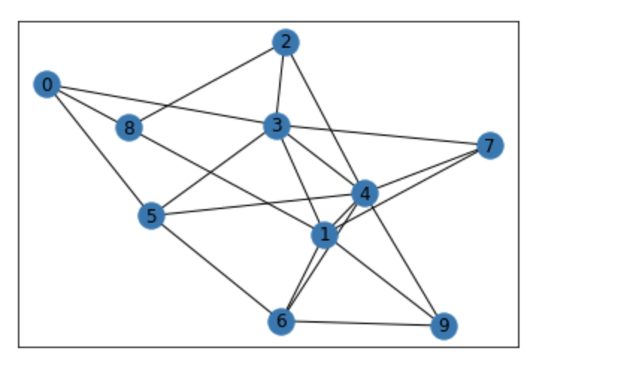
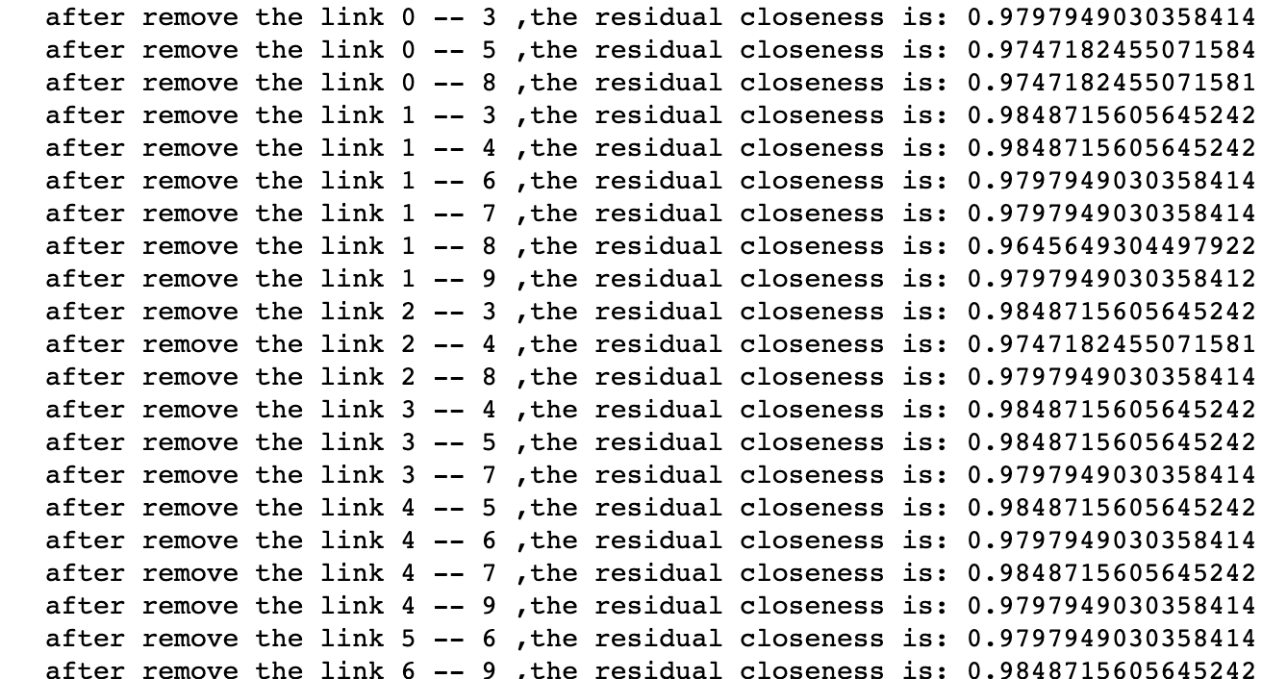
Example of Finding NLRC
Graph closeness=65.66
the link 1 – 8 will be the NLRC link
The residual closeness 0.9645649304497922

Slide 8
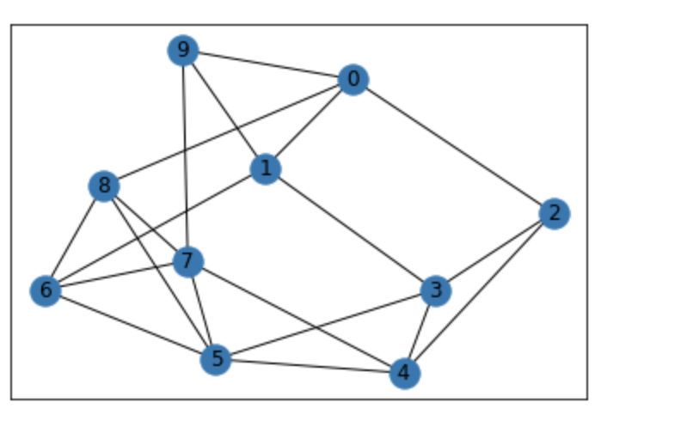
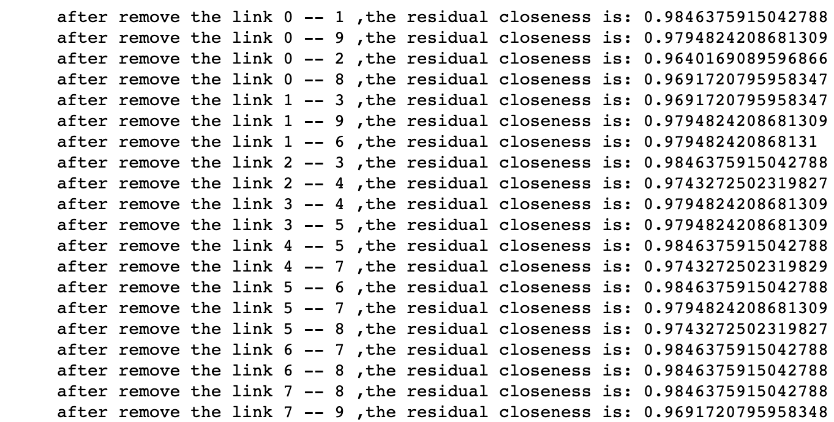
Example of Finding NLRC
Graph closeness=65.66
the link 0 – 2 will be the NLRC link
The residual closeness 0.9493349578637426

Slide 9
Upper bound and lower bound for NVRC
The VRC for the star graph is 0 .
Because after delete the hub, resulting graph will be all isolated graphs
Consider the complete graph with n nodes
closeness : n choose 2 = n(n-1)/2
It does not matter which node we delete, after we delete a node i,
Residual closeness (VRC): (n-1) choose 2 =(n-1)(n-2)/2
Normalized vertex residual closeness(NVRC) : (n-2)/n
Thus, NVRC is in the interval [0,1)

Slide 10
Upper bound and bound for NLRC
Consider a graph with only one link and n-2 isolated vertices,
the resulting LRC is 0.
Consider the complete graph with n nodes,
closeness: n choose 2 = n(n-1)/2
it does not matter which link we delete for a complete graph. Suppose we delete the link (k,p)
Residual closeness (LRC): n(n-1)/2 -1/2
normalized link residual closeness(NLRC) : 1-1/n(n-1)
i.e
Thus, NLRC is in the interval [0,1)

Slide 11
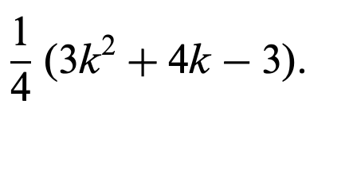
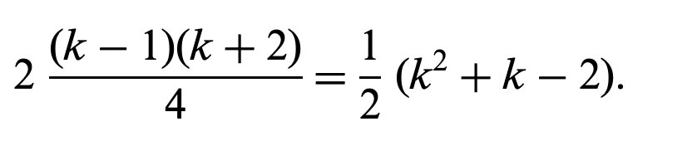
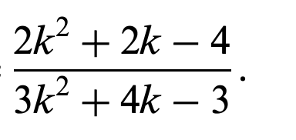
More on lower limit of NLRC
In previous slide, we discussed the scenario in which the resulting graph is completed disconnected.
Thus, the lower bound for NLRC is 0.
What about the resulting graph is not completed disconnected?
The scenario in which the resulting graph is two disconnected part.
Consider a graph with two star graphs linked by one edge.
closeness (C): :
after removed the linked edge in between,
Residual closeness (LRC):
normalized link residual closeness(NLRC):
Verification of LRC
For one star: 5*(1+1/2*4)+5
Total: 2*(5*(1+1/2*4)+5)
The lower bound for the above scenario is 2/3

Slide 12
Explorer More on VRC
Before, we only considered the case if we removed only 1 node.
What happens to the graph if we removed 2 node.
Trivial graph: star graph.
VRC : 0
The complete graph with n node : after removed 2 node, the graph will become a n-2 complete graph.
VRC: n-2 choose 2
The complete graph with n node : after removed k node ,where k <n , the graph will become a n-k complete graph.
VRC: n-k choose 2

Slide 13
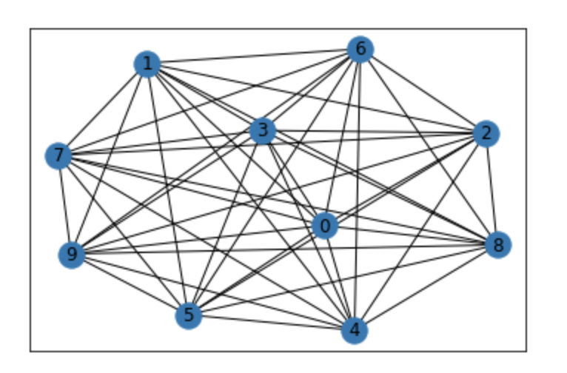
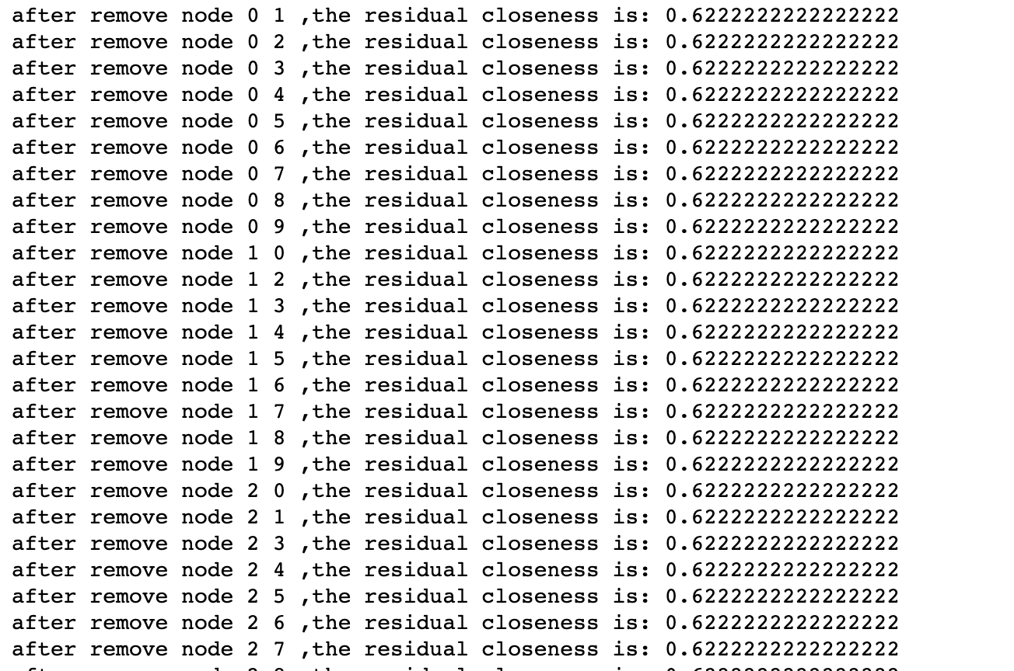
Example of NVRC for Complete graph
Graph closeness=65.66
after deleting any two node in the complete graph, the NVRC will be the same.

Slide 14
Explorer More on LRC/NLRC
Consider a complete graph of n node. Suppose we delete two link on that graph.
What is the LRC and NLRC
NN | 4 | 5 | 6 | 7 | 8 | 9 | 10 | …
LRC | 10 | 18 | 28 | 40 | 54 | 70 | 88 | …
NLRC | 0.83 | 0.9 | 0.93 | 0.95 | 0.96 | 0.97 | 0.98 | …
closeness: n choose 2 = n(n-1)/2
LRC=n*(n-2)+(n-2)
NLRC=2*(n*(n-2)+(n-2))/n(n-1)

Slide 15
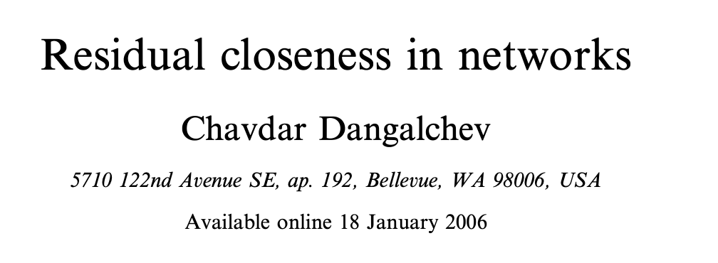
Reference paper

